Slide 1
Visual Representations
Data, Graphs and Tables
Melissa Hayes
PTC 605-851
Notes:
Today we’re going to focus on how we can present information visually. We will look at some real life examples from a journalist, an artist, a health expert and one of the foremost thought leaders on visualizing information and talk about some ways you can creatively present data yourselves. At the end of this presentations I’ll include some resource you can explore further on your own.

Slide 2
Seeing Beauty in Information
U.S. Budget Deficit: $901 billion
Global military spending: $1,617 billion
U.S. military spending: $739 billion
Money in offshore tax haves: $21,000 billion
Fast food restaurant revenue: $499 billion
Amazon market capitalization: $113 billion
Notes:
Let’s start with some basic numbers and how we can make them more visually appealing. (Animated Slide: click to reveal each line after reading the prior one)
As you can see on this slide, we have a bunch of numbers.
At quick glance, you can easily see that there is a lot of money in offshore tax havens. We also have a budget deficit that is larger than what we spend on the military, which is quite a bit.
But if we’re being honest, this is a pretty boring way to present a lot of numbers. There isn’t much to this visual.
Does anyone have a suggestion for a better way to present this data visually?

Slide 3
Charting information
Notes:
Here’s another way to display the same information. You can see that money in offshore tax havens far exceeds the other categories, but we already knew that.
What more can we do with these numbers?
Let’s take a look at what data journalist David McCandless came up with. These numbers are actually from the example I’m about to show you.

Slide 4
The Billion Dollar-o-Gram 2013
Notes:
(Ideally I would go to the website and show how the graphic is interactive.)
McCandless created the Billion Dollar-o-Gram, which is an interactive visualization. What does this show you that my bar chart did not? It gives you a better idea of the scale of numbers, doesn’t it? It is also color coded to group spending, earning, giving etc. There’s a lot more context here.
McCandless refers to this as an “information map.” You can check out this interactive graphic yourself at informationisbeautiful.net.
He has a lot of other great examples, including a visualization he developed to depict what our fears look like over time in the media. I’ll include a link to his Ted talk on the last slide for you to explore further.

Slide 5
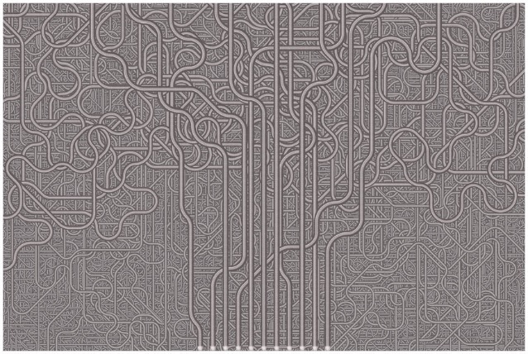
Turning Numbers into Art
Notes:
Next we’re going to talk about artist Chris Jordan who has found a way to visualize huge numbers through enormous works of art. He’s trying to shed light on things that can have catastrophic consequences. This is one of my favorites.
Take a moment to think about what this image might be. Any guesses?
Maybe some of you thought it was a picture of pipes. Let’s take a closer look. (click for animation)
It’s actually 1 million plastic cups, which represents the amount of cups used on airline flights in the used states every 6 hours. Jordan notes that we use about 4 million per day and they aren’t recycled.
His next image may surprise you even more.

Slide 6
Forty Million Paper Cups
Notes:
We use 40 million paper cups per day for hot beverages. Here’s what those cups would look like. They’d be as tall as a 42 story building. Jordan included the Statute of Liberty for scale and some very small, nearly invisible people to the left (click for animation) that I’m highlighting with an arrow.
Does this image make you think twice about using a disposable cup the next time you run out for coffee?
Chris Jordan takes on a lot of other interesting issues as well, like the number of people incarcerated in the U.S. and the number of people who die from cigarette smoking in our country each year.
Do any of you have a statistic that comes to mind that you could illustrate in similar fashion?
I’ll also include a link to the Ted Talk that Chris Jordan did at the end of this presentation so you can check it out.

Slide 7
Bringing Data to Life
Notes:
(Ideally I would go to the website and show how the graphic is interactive.)
Next I want to introduce you to the late Hans Rosling, a Swedish physician, who wanted to use data to explore development issues and debunk common myths. This image is a snapshot of an interactive visual that shows the relationship between personal income and life expectancy.
Rosling could have presented raw numbers when he presented at Ted in 2006, but he understood that the numbers themselves can only illustrate so much. Through the Gapminder Foundation, he helped develop free software, called Trendalyzer which turns the data into animated visuals and tells a story about the data. This static image doesn’t do his tool any justice. While Google purchased Gapminder in 2007, the software is still available for free on the foundation’s website.
Rosling’s goal with his software was to make data accessible and understandable to the masses.

Slide 8
Design Guidelines
Edward Tufte’s Essentials
Graphical Excellence
Visual Integrity
Maximizing the Data-Ink Ratio
Aesthetic Elegance
Notes:
Now that we’ve talked about some of the thought leaders in design and the different ways we can visualize numbers, I want to provide you with some guidelines for visual design.
Edward Tufte is considered the leading authority on data visualization. He has four main guidelines for information design: graphical excellence, visual integrity, maximizing the data-ink ratio and aesthetic elegance. Let’s quickly run through what these mean.

Slide 9
Graphical Excellence
Notes:
Tufte says data visualizations should provide, “the greatest number of ideas, in the shortest time, using the least amount of ink, in the smallest space.”
The Interaction Design Institute offers this graphic on U.S. employment statistics from Farcaster as an example that meets the criteria for Tufte’s definition of graphical excellence.

Slide 10
Visual Integrity
Notes:
Tufte stresses that visual representations of data should not distort the data or create a false interpretation of the underlying data.
What do you think he means by this?
One example of this would be scale. Take for example the bar chart I showed you earlier. This accurately represents the scale of these numbers. It portrays how much larger the amount of money in offshore tax havens is than the US budget deficit.

Slide 11
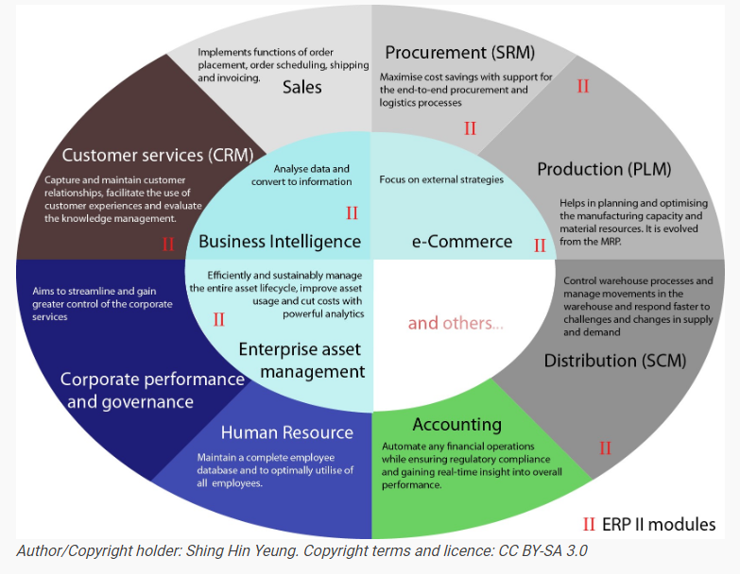
Maximizing the Data-Ink Ratio
Notes:
While decorative visualizations can seem like an appealing option, Tufte suggests that all extraneous elements be removed. He suggests that backgrounds or 3D elements can serve as a distraction from the data that is being presented.
The Interaction Design Foundation points to this example of business processes within an ERP environment. While the graphic includes a lot of good information, Tufte would have some suggestions for improving it.
Do you have any suggestions for how we could make this better?
How about the color scheme?
It doesn’t appear to play a role in the organization of the information being presented. Tufte would argue that the color scheme is actually a distraction.

Slide 12
Aesthetic Elegance
Notes:
The last guideline is aesthetic elegance. As I just noted, Tufte isn’t an advocate for decorative designs. Instead this guideline speaks to the simplicity of visualizations. The design should convey the complex information in a simplistic way that is easy for viewers to follow.
An example of aesthetic elegance that Tufte cites is this visualization by Charles Joseph Minard of Napolean’s March in the Russian Campaign in 1812 and 1813.
Tufte has called it “the best statistical graphic ever drawn.”
In addition to serving as a chart with data, this graphic is also a map that brings together six data sets: geography, the army’s course; the army’s direction; the number of remaining soldiers; the temperature and the time.

Slide 13
Assignment
Explore the public side of flowingdata.com and select five examples that you find interesting.
Write 200 to 300 words on why each of these examples speaks to you.
Notes:
Now that we’ve talked about what makes great visuals, it’s your turn to go out and fine some. Your assignment this week is to explore the public side of flowingdata.com and select five examples that you find interesting.
Write 200 to 300 words on why each of these examples speaks to you.
Here’s one that I found interesting. If you go to the website, you will be able to see the map transition from a static image to a cartogram. It really gives you some perspective on the different ways data can be presented and interpreted.

Slide 14
Resources
David McCandless Ted Talk (2010)
Information is Beautiful
Chris Jordan Ted Talk (2008)
Running the Numbers II (2009-Current)
Hans Rosling Ted Talk (2006)
Gapminder Visualization Tools
Interaction Design Foundation Article on Edward Tufte
Tufte presentation at the Microsoft Machine Learning & Data Sciences Summit
Flowing Data Example: Fixing the ‘impeach this’ map with a transition to a cartogram
Notes:
In closing, I will leave you with the resources that I discussed during today’s lecture.

